Slide 1
Fox international fellowship
Prospective Applicant Information Session
11 Dec 2024

Slide 2
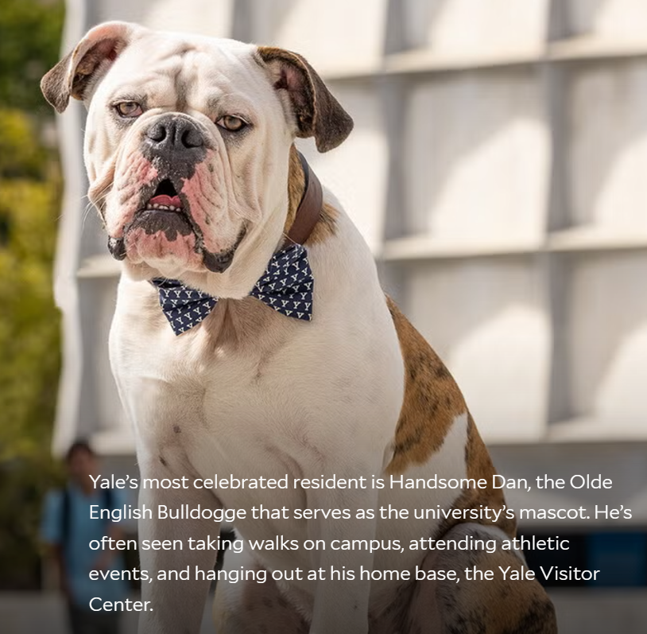
About the Fox International Fellowship
A prestigious graduate student exchange program between Yale and other top universities worldwide.
Fellows are selected for their potential to become leaders in areas of social impact, and the quality of their research.
Fellows conduct independent research at Yale University; and also audit classes, attend workshops, and network .
The program also offers access to an alumni network,
professional development and networking opportunities.
Notes:
Record the session – ask consent

Slide 3
Program Overview and Eligibility
Fellowship period: 10 months, from mid-August 2025 to 31 May 2026.
Each year: one ANU candidate to Yale, and one+ Yale candidates to ANU.
ANU nominates up to four candidates, who then submit a full application directly to Yale;
the Fox Fellowship Office makes the final selection
Fox Fellows undertake an independent research project for an academic year,
with a focus on Social Sciences or the Humanities
Open only to graduate students pursuing postgraduate research degrees;
Fellows must be enrolled in an ANU degree program for the duration of the Fellowship.
US citizens are generally not eligible to apply.
International candidates proposing projects in their home country are not eligible.
See: https://macmillan.yale.edu/foxfellowship/students-fox-exchange-partners
Notes:
The fellowship is a partnership between participating universities around the world, including Yale, Cambridge, and Tokyo University. Each year, up to thirteen students are selected to receive the fellowship and spend an academic year at one of the partner universities.

Slide 4
Selection Criteria
Personal characteristics: a commitment to research and a capacity for leadership and civic engagement.
Field of focus: Broadly, social sciences or humanities – candidates from other backgrounds considered if their focus is within scope. Interdisciplinarity regarded favourably.
Research Proposal: demonstrated excellence in their field of study is advantageous.
Academic Record: Candidates must provide all non-ANU transcripts.
Referees: Candidates must provide two recommendation letters from ANU faculty members.
Candidates must also have an excellent command of the English language. Each criterion is equally weighted
You should have made contact with at least some of the Yale faculty with whom you'd like to engage.
See: https://macmillan.yale.edu/foxfellowship/students-fox-exchange-partners
Notes:
To be eligible for the fellowship, applicants must be enrolled in a graduate program at one of the participating universities and have completed at least one year of study. They must also have a strong academic record and demonstrate a commitment to the field of global affairs.

Slide 5
Important Dates
18 Nov 2024 – Applications Open
8 Jan 2025 – Applications Close
4 Feb 2025 – ANU final selections
12 Feb 2025 – ANU nominates applicants
March 2025 – Yale final selections
15 April 2025 – Yale informs ANU of successful applicants
Notes:
The application deadline for the fellowship is usually in late November, and the selection period takes place in December and January. The announcement of awards is typically made in February or March. It's important to keep these dates in mind to ensure that you don't miss any deadlines.

Slide 6
FAQs
Will Yale sponsor my visa?
Yale will sponsor you for a J-1 Visa. Yale will also sponsor spouses and children for J-2 dependent visa(s).
Will Yale sponsor visas for my spouse and/or children in the U.S.?
Yes, Yale will help you support your visa application for spouse and children, but we cannot provide funding for their travel, living or health care expenses. You may be required to prove that you can support them during your stay at the exchange partner.
How much is the fellowship award for Fellows coming to Yale from Fox partner universities?
All Fellows at Yale receive the same award, which is commensurate to the level of funding received by doctoral students in the graduate school. Awards include round-trip travel, accommodation in rental housing provided by the Fox Fellowship and a generous living stipend to cover expenses not already provided for by existing funds that you may have at your disposal. The Fellowship will also cover health insurance. All fellows are also able to apply for grants from a research travel fund up to U.S.D $2000.
Can I receive extra funding for my family to join me?
In addition to visa support for a spouse and children, Fox Fellowship will provide a financial subsidy to fellows bringing a child/children to the United States. The final amount will be determined on a case-by-case basis. Please note that the U.S. government also requires proof of health insurance for the entire family.
Further FAQs available here
Notes:
Each fellow receives a stipend to cover living and travel expenses, as well as access to research resources, such as libraries and archives. The fellowship also provides opportunities to attend conferences and workshops, and collaborate with scholars from around the world.

Slide 7
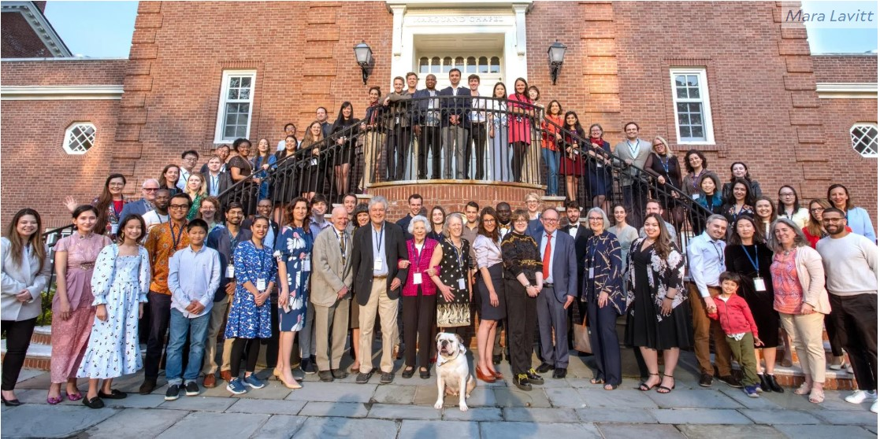
Apply by 8 January 2025!
A complete application must include:
A completed Application Form
ANU Academic Transcripts
Two recommendation letters from ANU academics (or equivalent)
Completed applications must be submitted via email to gro@anu.edu.au by COB 8 January 2025.
W: Fox International Fellowship​
E: gro@anu.edu.au​​
Notes:
We encourage all eligible students to apply for the Fox International Fellowship. If you have any questions, please contact us at [insert contact information].

Slide 8
Panelists
Medha Majumdar, Fox Fellow (ANU to Yale) 2021 - 2022
Nathan Wiltshire, Fox Fellow (ANU to Yale) 2022 - 2023
Dyah Pritadrajati, Fox Fellow (ANU to Yale) 2024 - 2025
Xianda Huang, Fox Fellow (Yale to ANU) 2024 – 2025
Not here, but can respond to emails:
Polina Polianskaja, Fox Fellow (ANU to Yale) 2023 – 2024
My background is in social anthropology and my work is a polyphonic ethnography of transformative choice in Myanmar's Spring Revolution. I am interested in, how in times of intense political upheaval and uncertainty, ordinary people make extraordinary choices and in what shapes those choices.

